Slide 1
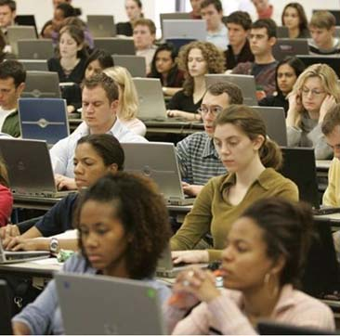
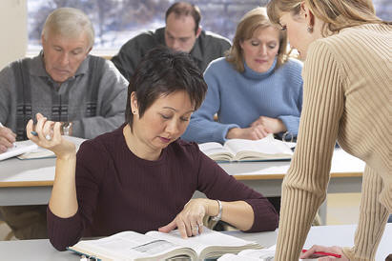
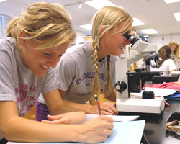
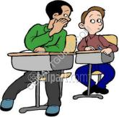
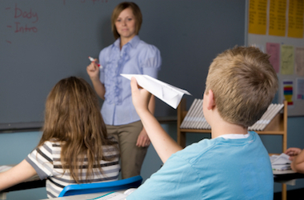
Viva la clase
Por Coralie Turner y Amy Schumann
Grand View University
Notes:
Comment on slides
Previous learning/teaching experience….background demographics…Ask audience? What is your classroom look like? What class do you look forward to and/or is a challenge?

Slide 2
Fire up!!!
To
motivate
and
empower
students
to
communicate
Notes:
Dialog of Teacher and Students on first day of class…spanish language experience, positive or negative, teacher discussion….etc. What are some fun things you have done to fire students up? Setting the stage… First class sets the TONE!!!!!! Greetings-short, quick activities, (timed) conversation-cita rapida….people bingo….Memory exercise

Slide 3
How are we as TEACHERS motivated and empowered?
Building rapport with students
Experiencing success in teaching inside and outside the classroom
Engaging and interacting with students’ energy
Passion to teach and learn
Notes:
How do you know your effectively teaching? How do you communicate your passion?…………previous experiences….Class went so fast…. I love this class…You know you are really good at Spanish…I know I want to take all of the classes I can…You can’t give someone a passion…but can you foster it in student teachers or new teachers, how?

Slide 4
How are STUDENTS motivated?
Positive rapport with teacher
Experiencing success!!!
Engaging and interacting
with others
Notes:
I went to a Spanish restaurant last night and ordered in spanish. I was shopping in wal-mart and I could understand they were talking about colors and sizes.

Slide 5
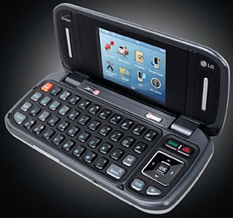
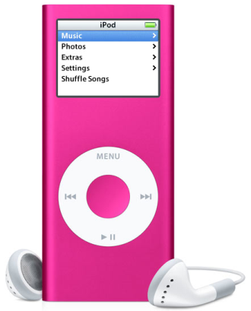
How do we motivate communication?
Challenge students
Give students topics that interest them (Facebook, Twitter, sports, prom)
Allow adequate class time to practice
Constructive feedback
Notes:
Connections…TPRS…..Danish students thoughts new, current methods….

Slide 6
Activities that lead to Ss success
Activity 1-Cita rápida
Activity 2-Crayones-mapa de una ciudad…
Activity 3-Texto rápido-tema
Activity 4-Sorpresas
Activity 5-Otros ejemplos-tiza, fotos, objetos (el oso, el arete), memoria de gente,
Notes:
Que hiciste el verano pasado? Donde asististe la universidad y por que? Activity 2-mapa-conclusions-give students input and ownership-

Slide 7
Tips for student practice
Pair activities: conversations, rhyming, texting…
Envelope activity
Practice what the students performance goals/rubric is asking for
Work on comprehension and comprehensibility - Is the student able to understand and be understood?

Slide 8
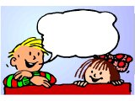
Sustaining Conversation
What happens if communication fails?
1) Circumlocution
2) Strategies to negotiate meaning
3) Phrases that show students are engaged
Notes:
* Students need tools to be successful. 1) Reward students for using this. 2) Brainstorm strategies 3) puedes explicar mas….entonces estas diciendo…es que…dime mas..

Slide 9
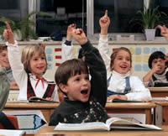
Sustaining Conversation
Students need to be:
Helping
Reacting
Engaging
Listening
Responding

Slide 10
Resources
“Spot the Difference” books - spot the differences or go a step further…Como se siente la mujer en la foto? ¿Por qué piensas eso? Es obvio que …
Libro de ropa - description - feelings…where did he/she buy the clothes?, why?, etc.
Perfect Square by Michael Hall

Slide 11
Assessment
What are you looking for and how do they measure up?
What?
How?
Why?
Teachers and Students!
Teachers←→Teachers
Teachers ←→Students
Students←→Students
Notes:
How are you assessing? Collaboration, reflection, seeking new methods, classroom differentiation according to your classroom needs…coralie-dottie amy-students from other countries-danish…teachers-retired teachers…valued and used…colleagues-recent graduates-alumni—student teachers

Slide 12
Conclusion
Visualize creating a memorable classroom.
Intention – Motivate! Motivate! Motivate!
Validate – Empowered students succeed!
Assess/Acquire continually…

